Slide 1












#MSTechCommunityAPACOnline
Tech Sharing
Industrial Transformation with
Microsoft Mixed Reality &
Dynamics 365
By Adityo Setyonugroho, Senior Software Engineer, Dattabot

Slide 2
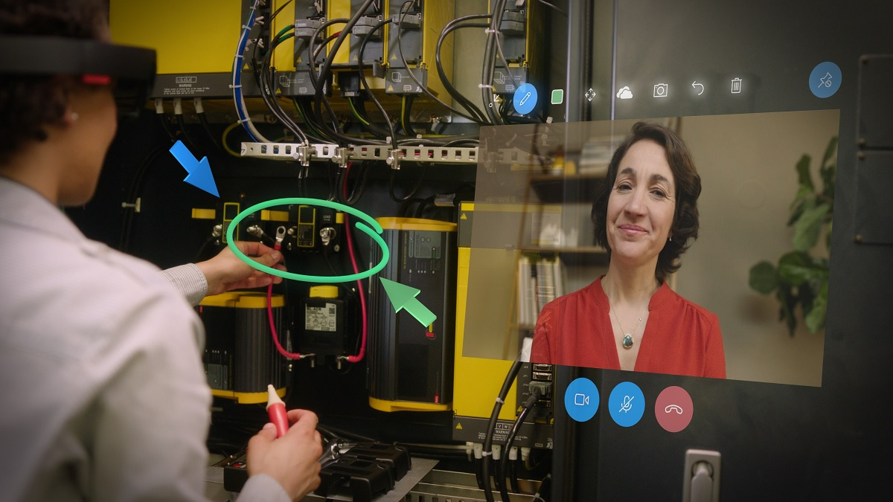
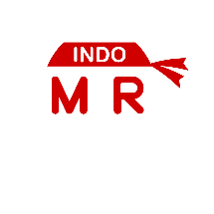
Industrial Transformation:
Microsoft Mixed Reality & Dynamics 365
Mixed Reality
Community
Indonesia

Slide 3
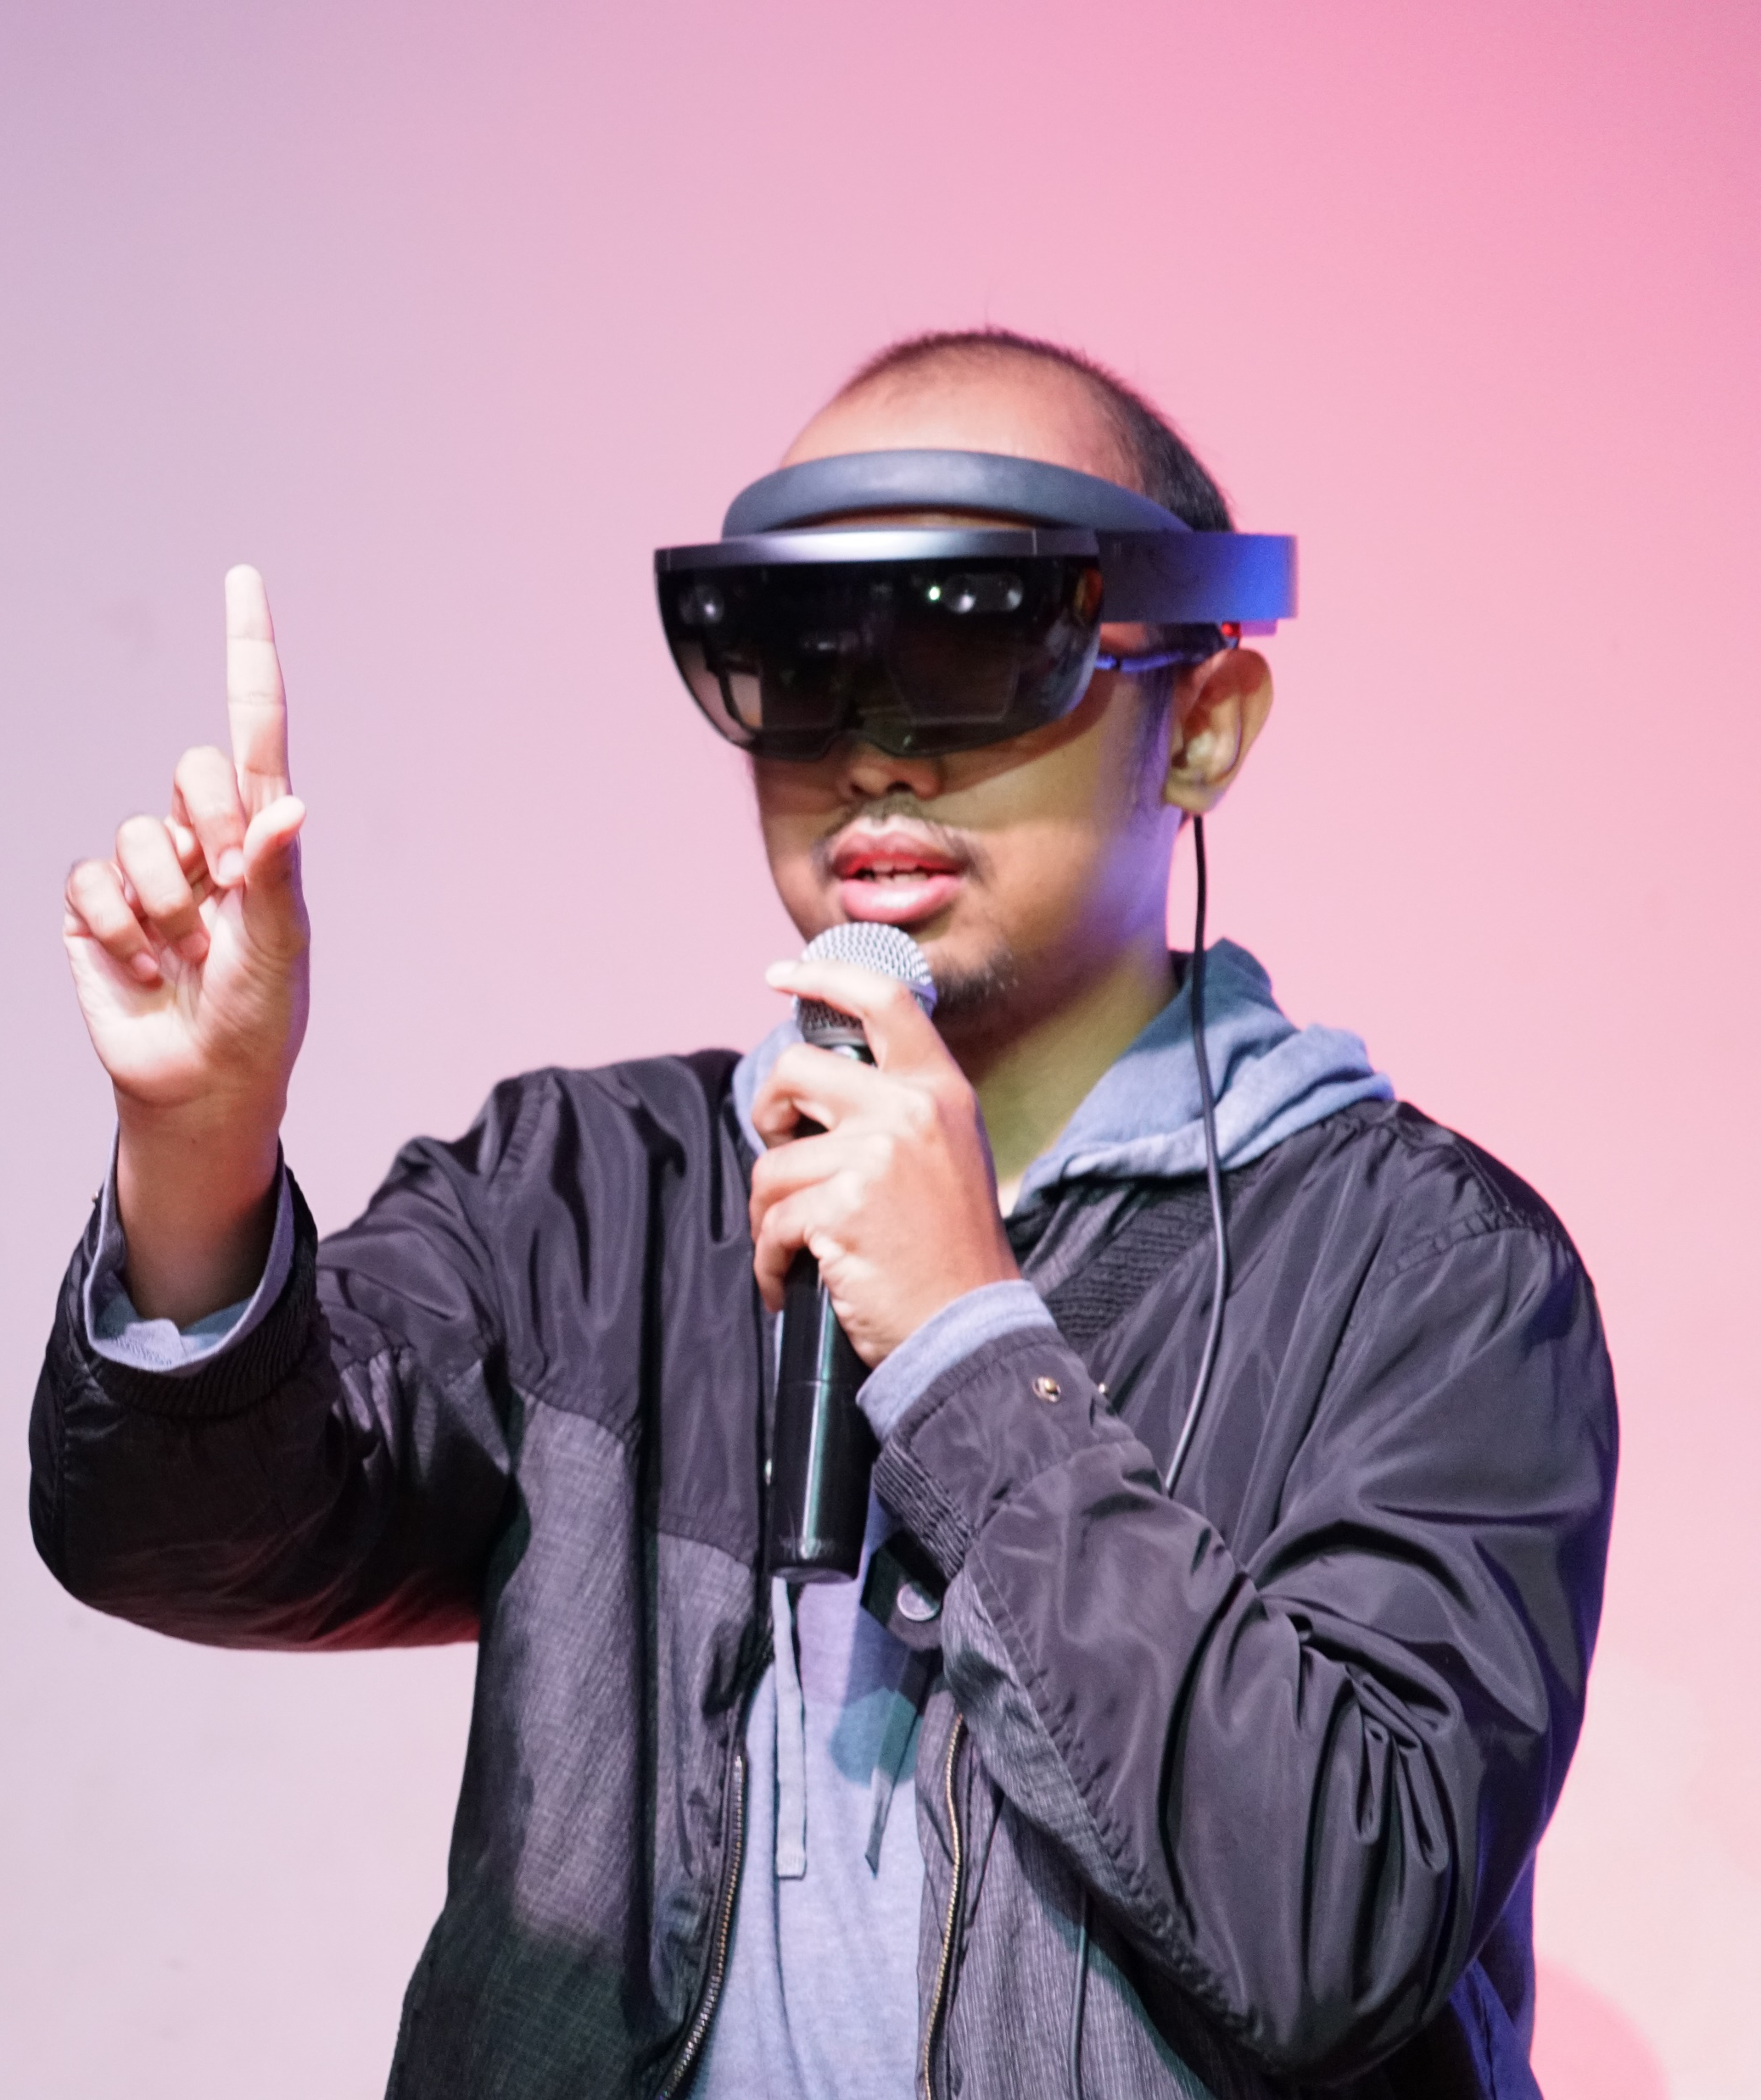


About Me
Adityo Setyonugroho
Software & Cloud Engineer
Mixed Reality, Cloud, & Artificial Intelligent
Dattabot, Hologram Indonesia
Mixed Reality Community Indonesia
@adityosnrost
Adityo Setyonugroho

Slide 4
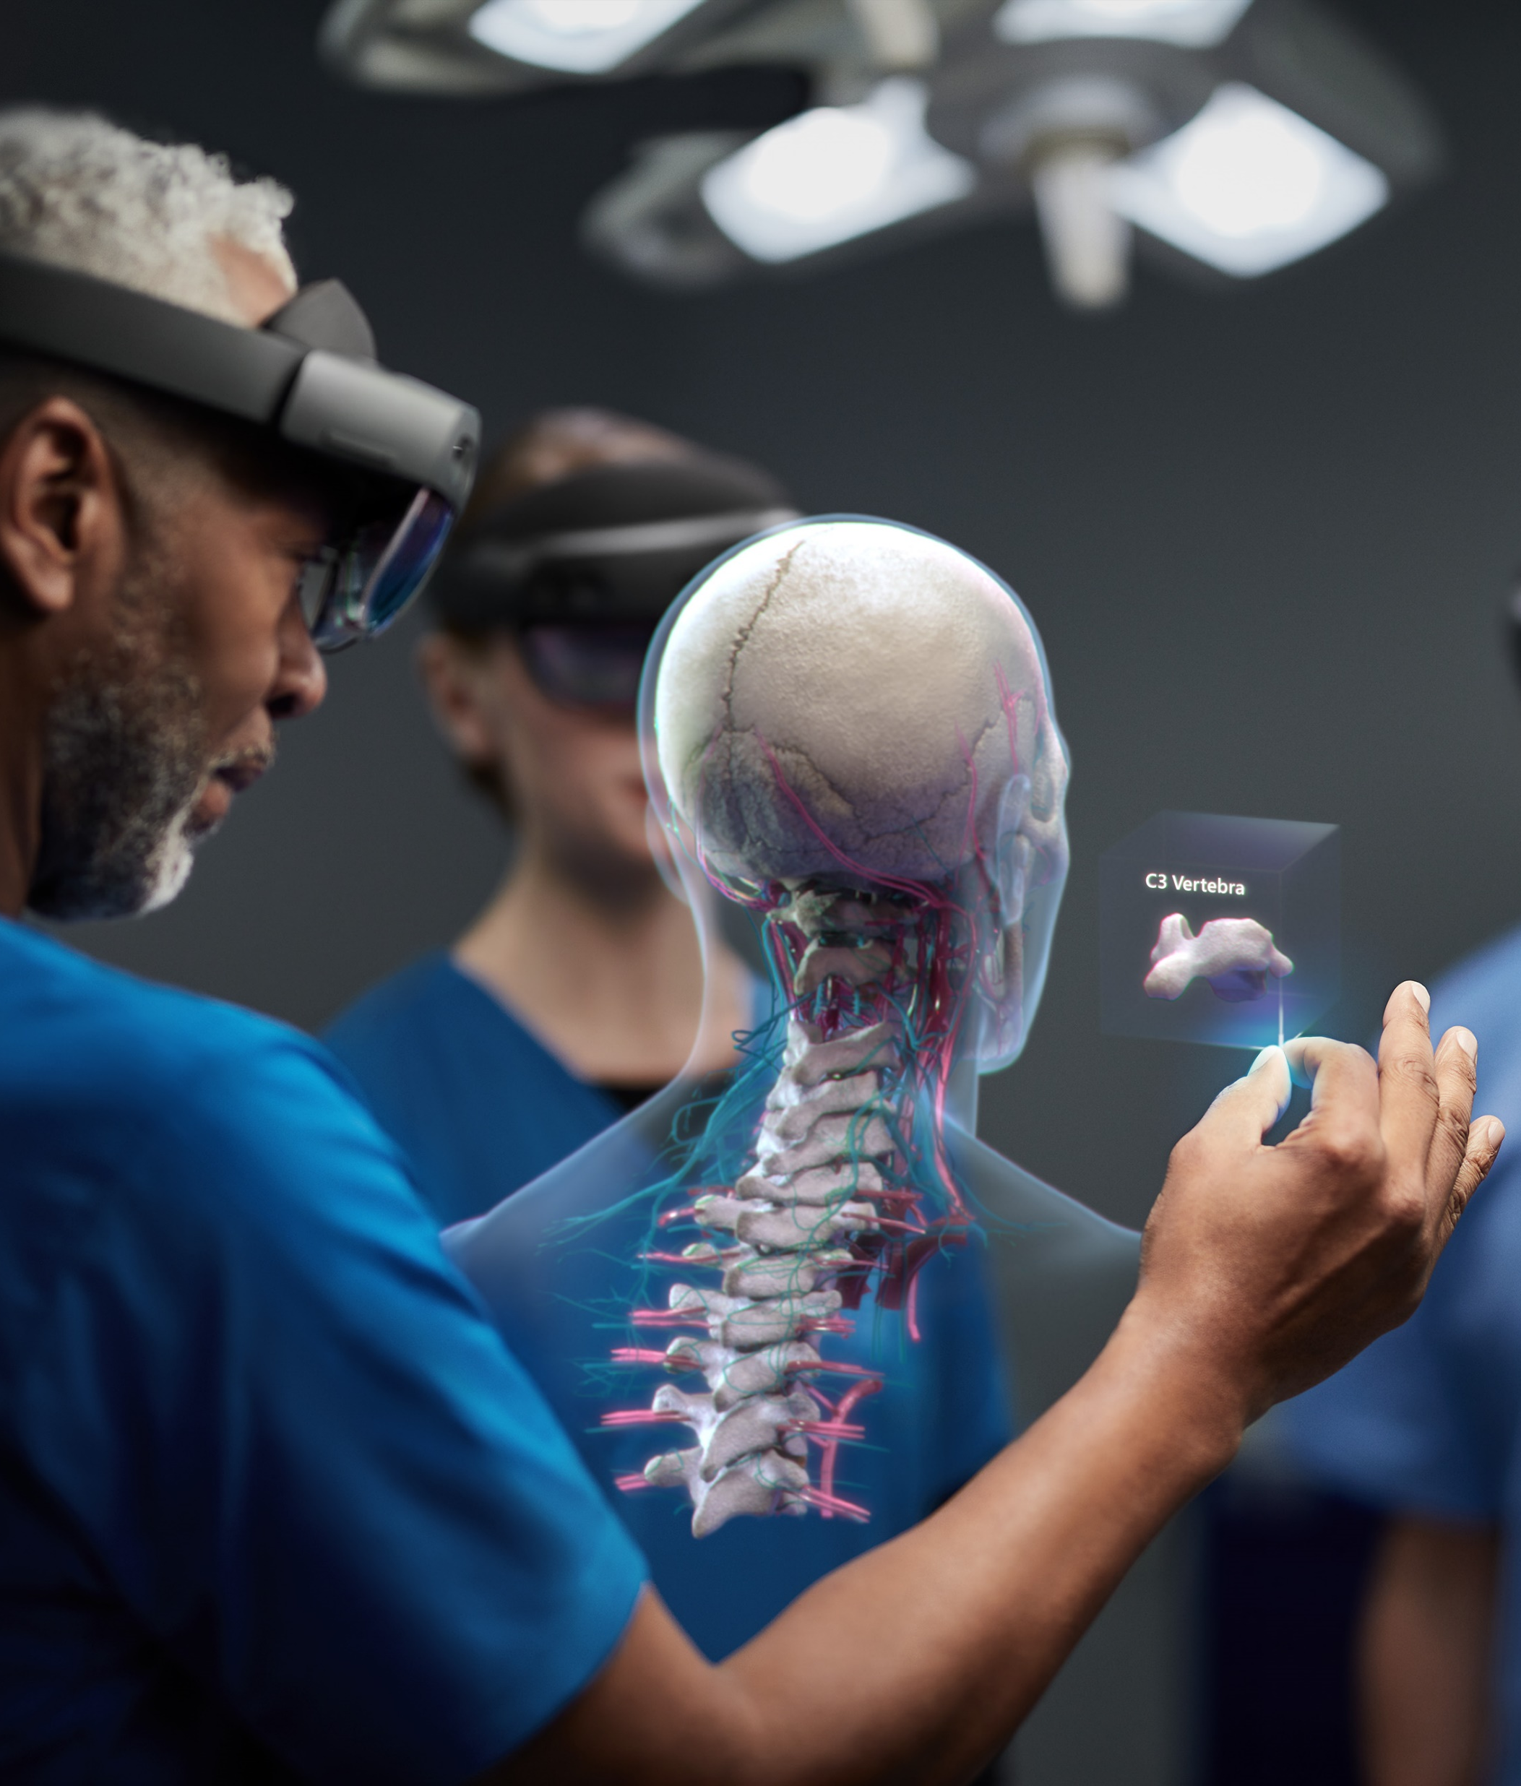
Welcome to The New Reality

Slide 5
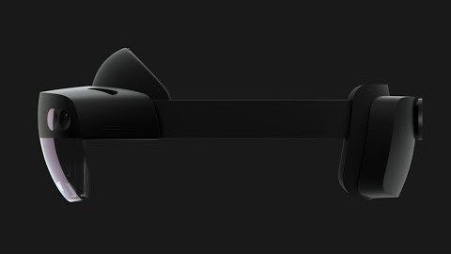

Slide 6
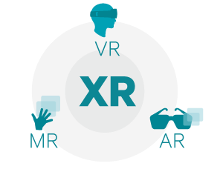
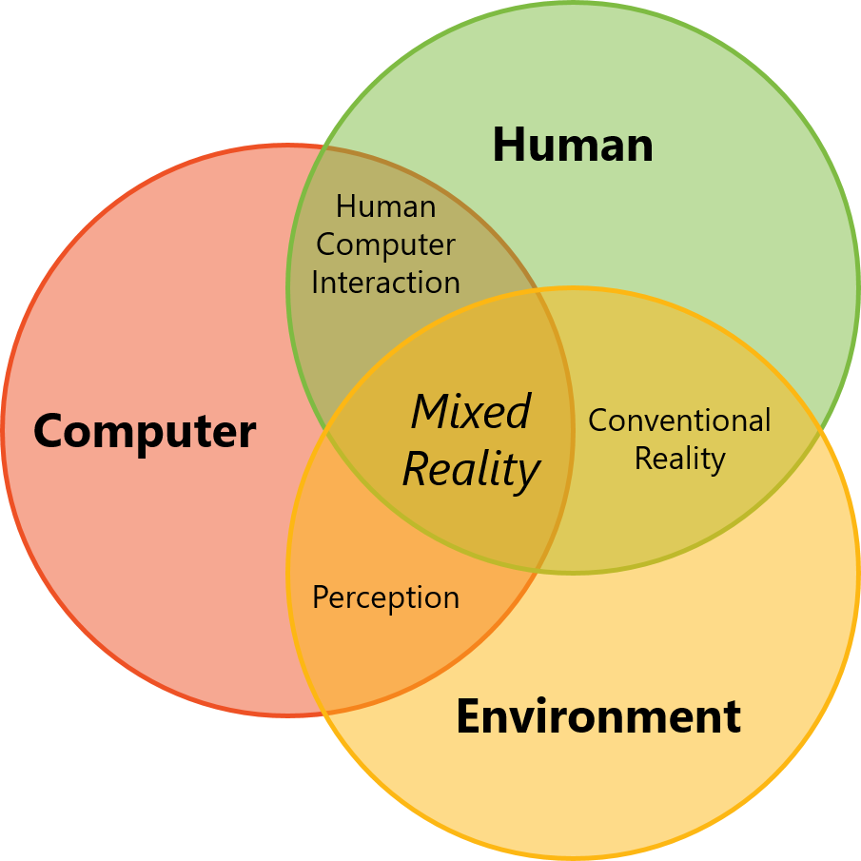
AUGMENTED REALITY | MIXED REALITY | VIRTUAL REALITY
Real World Environment | Real and Digital World Combine | Digital Environment
Digital Object Overlaid Over Real Environment | Digital Object Interact With Real World | No Real-World Interaction
Device Interaction | Device and Natural Interaction | Additional Tools to Interact

Slide 7
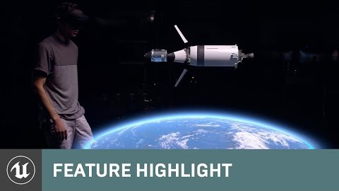

Slide 8
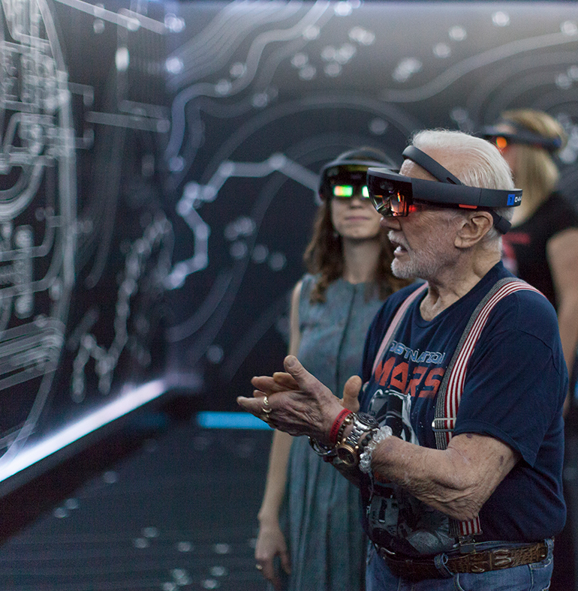
Let’s Transform
Your World
with Mixed Reality

Slide 9
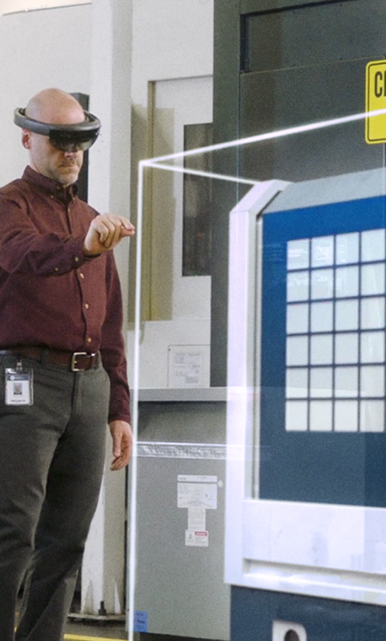
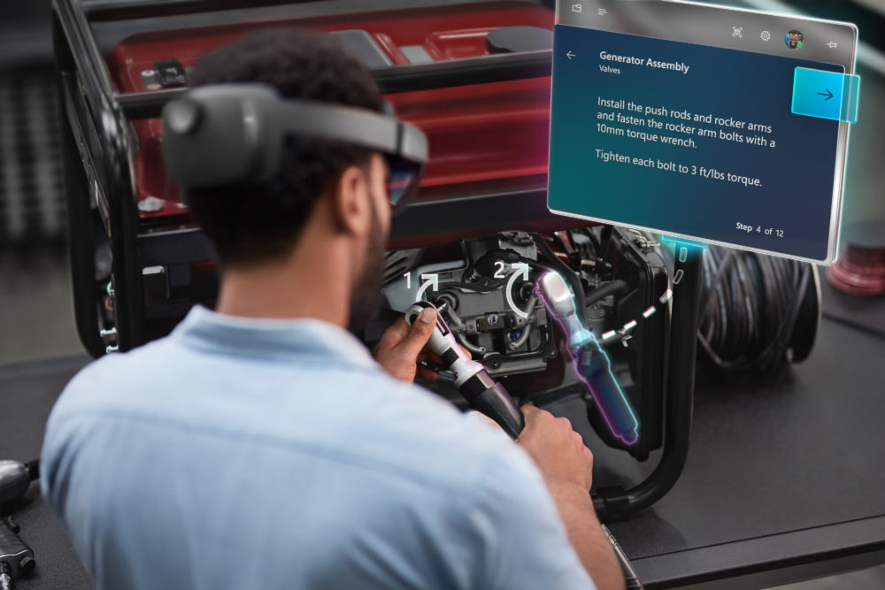
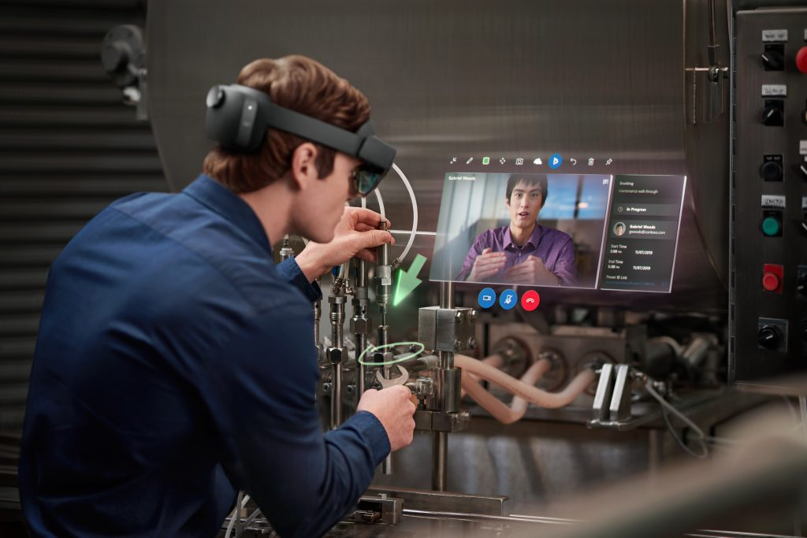



Microsoft Dynamics 365
Guides
Microsoft Dynamics 365
Remote Assist
Microsoft Dynamics 365
Layout

Slide 10
How Mixed Reality with Dynamics 365 Can Help You?
Help you understand
Connect to help you
Visualized your workspace
Mixed Reality can help you to learn about your works or tasks more interactives and immersive.
By guiding you through holographic lessons helper, you can focus on your task without being distracted by unneeded actions. Help you to save your time and easier to understand things that you need.
Looking for easier guidance or help on your site problem?
By using holographic collaboration, you can working together with colleagues or experts efficiently on the problems in real time. Share your view and getting insight remotely
Through holographic visualization on your workspace, you can manage and design your space in real time and real view on how it is going to be like.
By using Mixed Reality technology on understanding environment, you can efficiently calculate and manipulate your space based on what you need.
And more things you can do with Mixed Reality

Slide 11
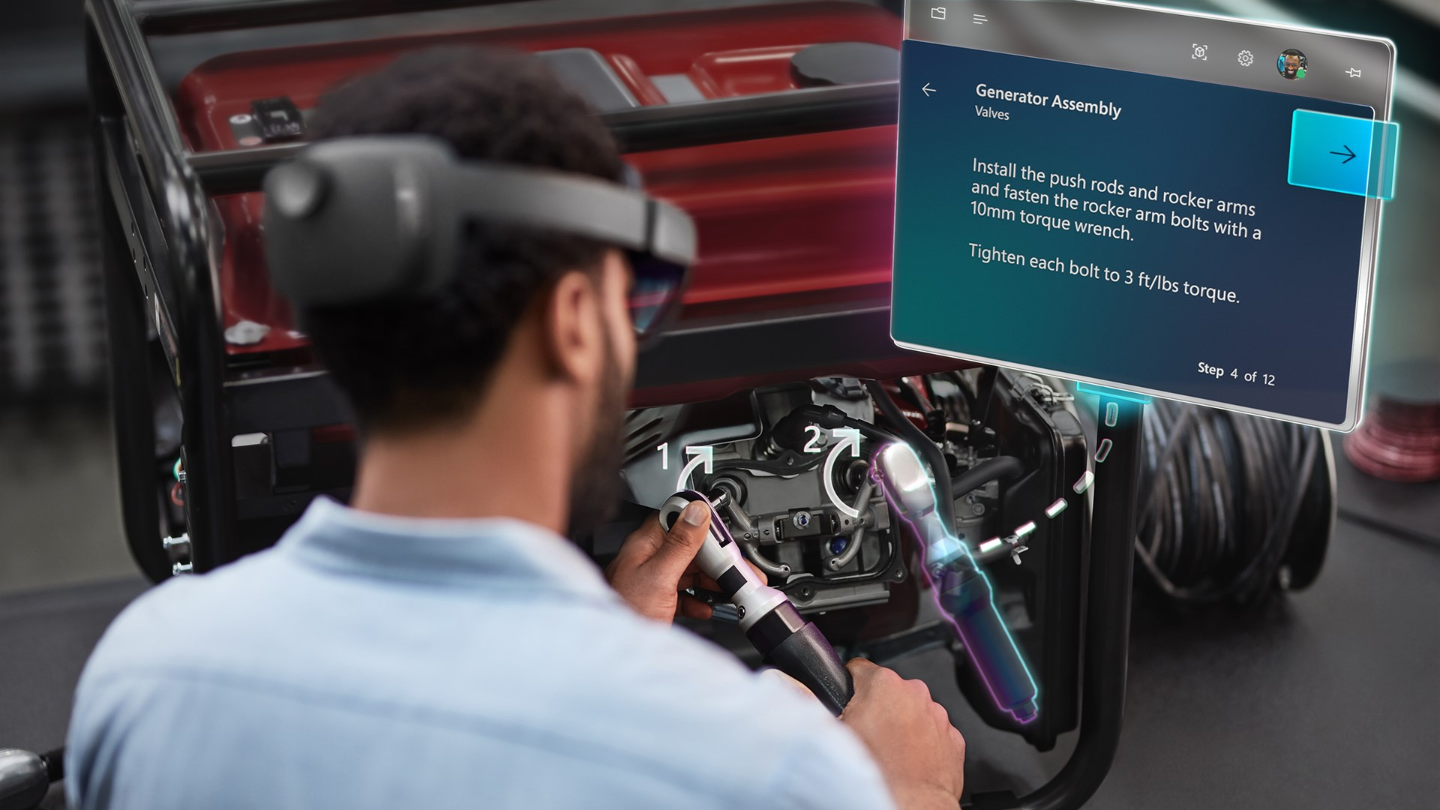
Microsoft Dynamics 365
Guides

Slide 12
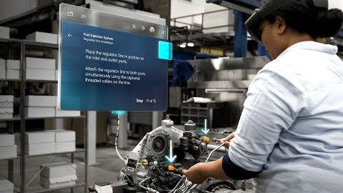

Slide 13


Overview of Guides
Hands On Learning
User directly learning on the subject. So, they are familiar with the real situation.
Holographic Manual
Guidance through hologram view help user focusing learning on the subject rather than searching on printed manual or screen interaction-based device.
Microsoft Dynamics 365
Guides
Fully Customized
Make your interactive and effective learning path based on the company needed.

Slide 14
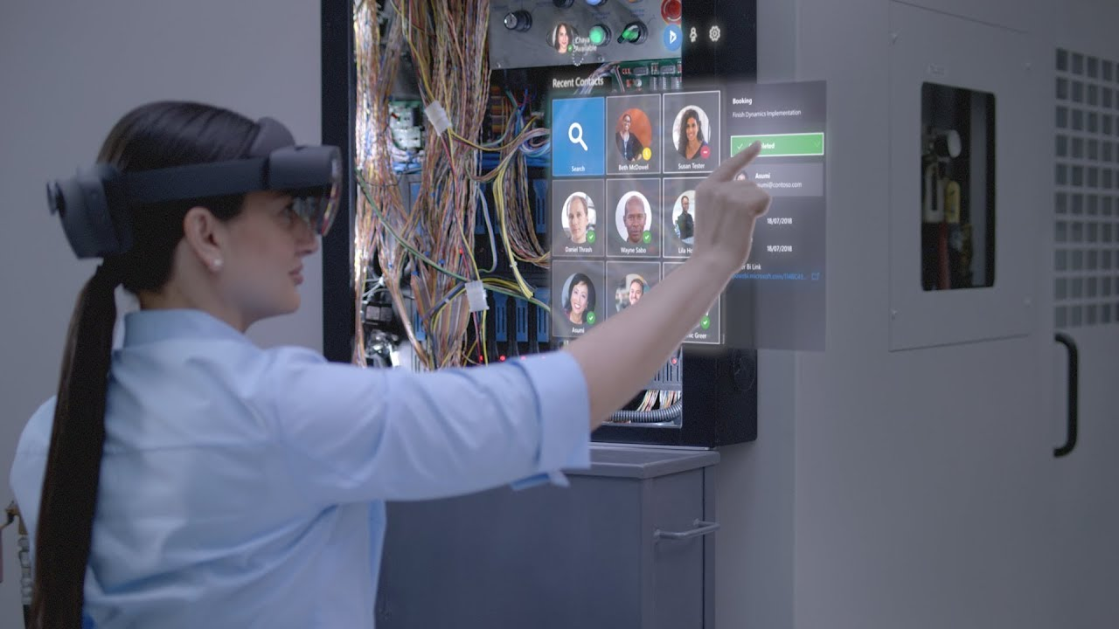
Microsoft Dynamics 365
Remote Assist

Slide 15
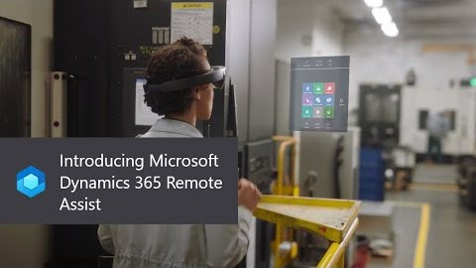

Slide 16
Overview of Remote Assist
Collaborate to Solve
Connect with colleagues or experts to solve site problem faster and efficient
Share information
Share anything between you and your partner such as images, pdf, voice, text, etc
Microsoft Dynamics 365
Remote Assist
Connect other services
Use Dynamics services along with Office 365 platform to maximized your information that you need. Also, along with other Mixed Reality apps

Slide 17
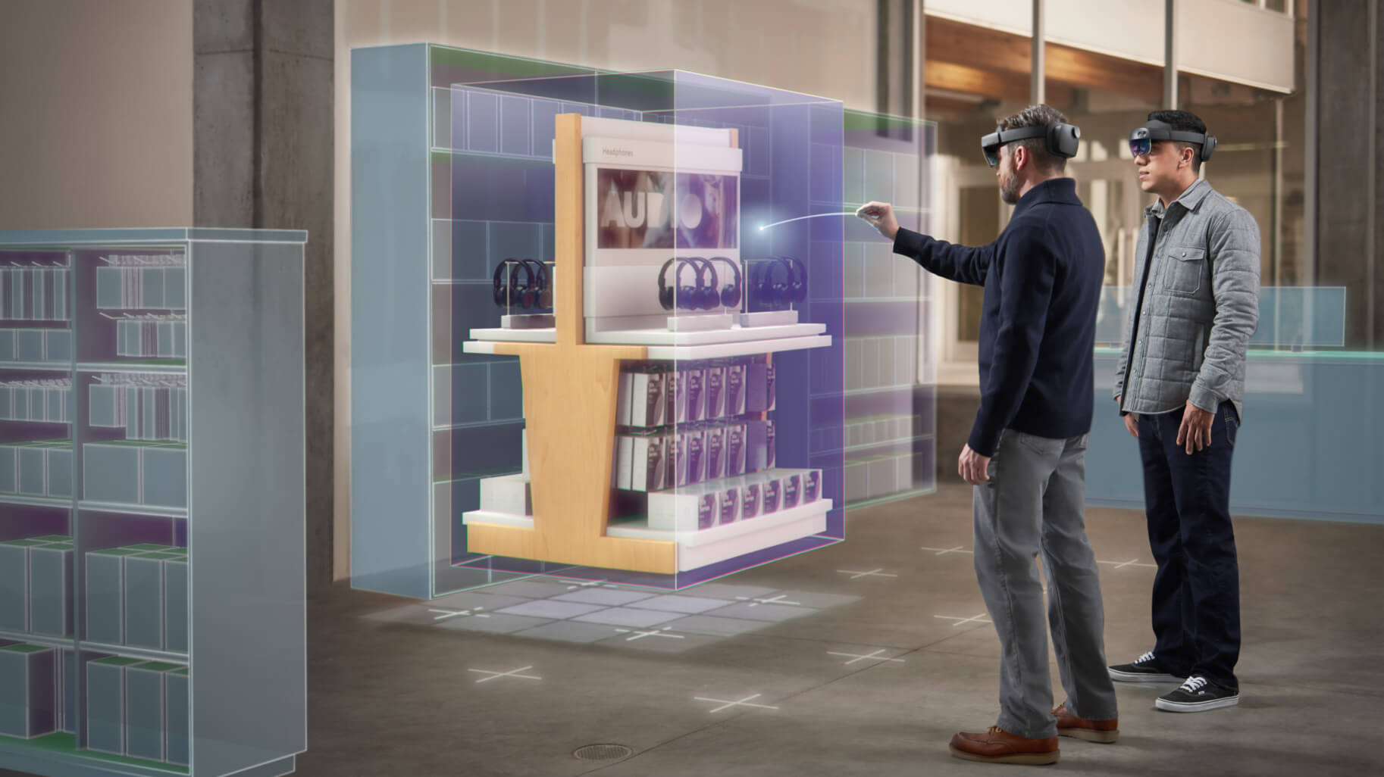
Microsoft Dynamics 365
Layout

Slide 18
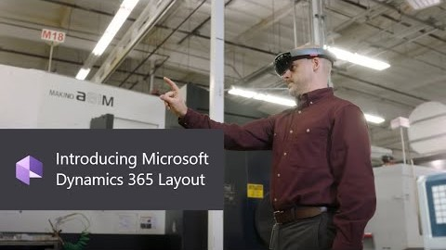

Slide 19
Overview of Layout
Workspace Plan
User directly learning on the subject. So, they are familiar with the real situation
Custom Hologram
Guidance through hologram view help user focusing learning on the subject rather than searching on printed manual or screen interaction-based device
Microsoft Dynamics 365
Layout
Share & Collaborate
Make your interactive and effective learning path based on the company needed.

Slide 20
Building Blocks for
Mixed Reality Developers

Slide 21
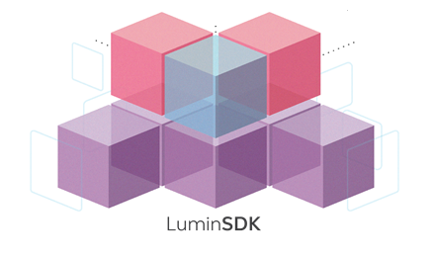




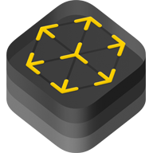



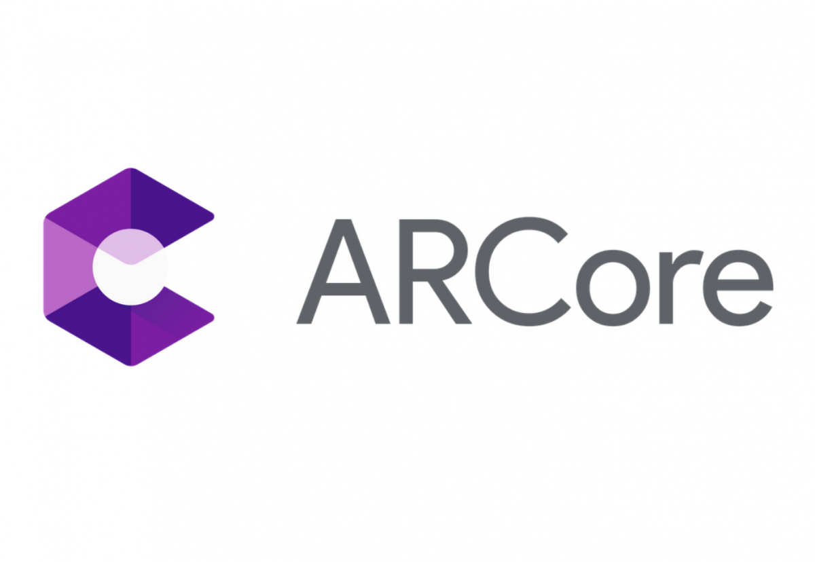

Engine & Toolkit

Slide 22
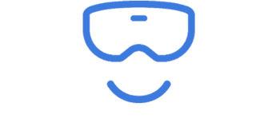
Thank You

